Slide 1


ASE 16 sp 02 “Corona”: Technology Preview
Customer
Jeff Tallman jeff.tallman@sap.com
SAP ASE Product Management

Slide 2
ASE 16
Altering your perception of ASE
ASE Cluster Edition Roadmap
Clustering for availability vs. horizontal scaling
ASE CE 15.7 sp130+
ASE CE 16.0 and beyond
ASE 16 sp02 Features
DSAM (Storage Tiering)
Accelerator for ASE (A4A)
Always On (HADR)
MemScale (XOLTP)
SSD Buffer Extensions
Workload Analyzer (Capture Replay)

Slide 3

ASE & DBMS Fact vs. FUD
Unbending your mind about ASE’s capabilities…and database technology in general

Slide 4



Is This Your View of a Typical ASE Customer?
Primarily a single application instance
Likely <1TB in size
May have a HADR copy
Using standby data replication or disk replication
May have a reporting “sidecar”
Could be same DBMS or Analytics DBMS
Loaded via data replication or ETL (batch)
Longer data retention
Similar but not exactly same schema
Interactions with other applications/systems
Typically message based
Likely low volume (10’s of thousands per hour)
Yes – we do have a lot of these …and gaining
Trizetto FACETS
Murex
Thompson Reuters/Misys KONDOR+
SAP ERP
…in other words COTS LOB applications
Many of these are not so small
Many FACET sites are 5TB+

Slide 5

The Reality: A Typical Large ASE Customer
North East
Mid-Atlantic
North West
Operates a corporate environment
Virtual cluster of 5 ASE nodes in 3 Data Centers
1 is R/W, the other 4 are R/O
Any node can take over and be the writer at any point
4 OLTP @ ~9TB w/ 1.5TB memory in ASE
1 historical @ 20TB (North West DC) in ASE (yes ASE)
Transaction Processing
Each node
~8000 connections active
performs 200 billion LIO but only ~100K physical reads
Essentially in-memory XOLTP
High write volume
Note that due to replication, each node has to sustain identical write volume
Low latency replication in order to support HA functions (fast RTO)
Manages 15 trillion $US in assets
Replicates to 30 customer environments
A pair of ASE’s @ 1TB each
Primary and Standby
Customer Environment
Customer Environment
Customer Environment
Corporate Environment

Slide 6


The Reality 2: A Typical Large ASE Customer
Global/regional distributed virtual cluster
Each local site has a separate instance of database
Reduce application transaction latency
Microsecond response desired
Autonomous operations (resiliency)
Each local site also has a near-by standby system
Regional data security/privacy and general accounting regulations make it difficult to leverage out-of-country systems for standby purposes
Number of sites typically in the mid 10’s (20+)
Number of systems in the 100’s to 1000’s
Transactions are replicated to all other sites
Corporate reporting/central risk management
Follow-the-sun processing
Common to FSI….and other industries
Manufacturing, Transportation, etc.

Slide 7
The Reality 3: USA & US-FSI is no longer dominates technology
No argument that it is still a leader
However, many other regions & industries have just as complex architectures/large scale systems or are catching up
Highest transaction rate systems → typically APO with some LAO
Population driven → Country (APO) or Large City (LAO)
Telco (especially mobile phone – e.g. SMS ala SY365), Transportation (passenger rail/shipping)
Retail Banking, Gov’t Central Banks (e.g. LAO → 1.5TB in 1 table)
Manufacturing/Supply Chain Management
Off-shore technology workers
Sensor/Streaming data eclipsing FSI trading volumes
John Deere has instrumented tractor engines
Not just for QA - collects metrics remotely for repair diagnostics/alerts
One word “IoT”…okay, that’s 3….Internet of Things
Big Data/Largest Systems – EMEA, APO
IQ largest volume/highest load speed POC was done for South Africa
European Space agency building multi-petabyte DB on Oracle (space imagery)
CERN often quoted by Oracle for transaction volume/speeds

Slide 8
The Reality 4: Open Source is not out-innovating
XOLTP is all COTS
Streaming data/event stream processing
In-memory database technology
RDBMS Analytics is COTS
In-memory Analytics (HANA, Oracle, MS SQL, DB2 Blu)
Column store/massive scale (IQ)
Open Source often has scalability/reliability issues
Query optimization is a PhD science
Result is OpenSource DBMS typically have performance issues with complex queries with larger datasets
Extreme scaling is a work-smarter not harder (e.g. massive brute force) and is business critical
Partnerships with HW for chip-level API access/development to solve problems at higher scale cheaper than MBF
There are undeniable trends…
Non-relational (e.g. Casandra) often used as a application cache vs. middle tier caching
MongoDB, etc. used for graph query support
Hadoop for unstructured data is only real success
….and even then Hive, etc.

Slide 9
SAP ASE 16 Case Study: A Data Management Challenge of Massive Scale
Total AIRLINE Passengers in the US, 2012¹
813
Million
Total RAIL Passenger in China, 2012²
1.9
Billion
During the Lunar New Year, 283 million passengers in 1 week
That’s like putting the entire USA population on AMTRAK….
¹ TranStats, Bureau of Transportation Statistics
² China Statistical Yearbook (Abstract) 2013

Slide 10



China Academy of Railway Sciences
China Academy of Railway Sciences was founded on March 1st, 1950. Today, it supports one of the largest railway ticketing systems in the world.
Ticketing System Requirements:
Handle growing transaction volume especially during peak travel season
Process 3+ billion transactions per day and 9.3M tickets sold in peak time with 30+ SAP ASE nodes
Geographically distributed in ~18 regional datacenters with central reporting
Enable superior customer service
Linear transaction scalability up to 64 cores w/ ASE 16.
Typical Environment:
Hardware: IBM P750
OS: AIX 6.1
CPUs: 64 cores
Memory: 512GB
5.5M
More tickets sold every day
4K+
Passenger trains in use every day

Slide 11
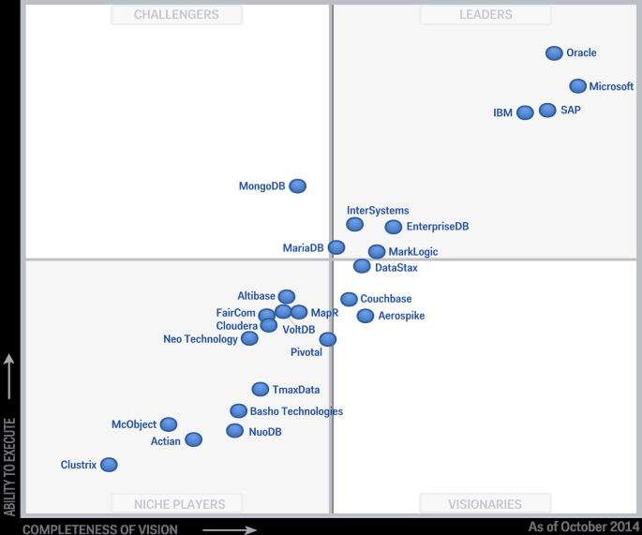

SAP ASE – Highlights
30K
~8K
66%
20+%
2014 Gartner Magic Quadrant for Operational Database Management Systems
SAP Business Suite Installations on SAP ASE
SAP HEC Cloud Deployments on SAP ASE
Growth rate of SAP Business Suite migrations to ASE
Customers
ASE used internally by SAP IT in 75 Core Business Applications
HANA Enterprise Cloud hosting 1,100+ Instances of SAP ASE
Out-innovating IBM at Operational Databases (2014 Gartner MQ)
200 SAP ASE patents filed & 150 pending
SAP ASE Appliance with Fujitsu
Strong partnerships with Dell, VMware, Violin, AWS and more
SAP ASE Developer Center on SAP Community Network
SAP ASE 16 – Foundation for next-generation OLTP applications
SAP operational databases in the Gartner analysis include: SAP HANA, SAP ASE, and SAP SQL Anywhere
Source: Gartner, Magic Quadrant for Operational Database Management Systems by Donald Feinberg, Merv Adrian and Nick Heudecker, October 16, 2014.
Gartner does not endorse any vendor, product or service depicted in its research publications, and does not advise technology users to select only those vendors with the highest ratings. Gartner research publications consist of the opinions of Gartner's research organization and should not be construed as statements of fact. Gartner disclaims all warranties, expressed or implied, with respect to this research, including any warranties of merchantability or fitness for a particular purpose.

Slide 12
SAP ASE 16 Performance & Scalability Results
#1 & #2 on SAP SD Benchmark
Linear Scalability in OLTP
31000
1M+
# of users
Concurrent business transactions
#1 → 170030 SAPS
Dell PowerEdge R930
RedHat Enterprise Linux 7.1
4 sockets / 72 cores / 144 threads
#2 → 169430 SAPS
HP ProLiant DL580 Gen9
RedHat Enterprise Linux 6.7
4 sockets / 72 cores / 144 threads
TRANSACTIONS/MINUTE
Certification #2015012 & #2015020, valid as of May 5, 2015. Details can be found at http://www.sap.com/solutions/benchmark/sd2tier.epx
CPU CORES
Internal OLTP benchmark
Notes:
http://global.sap.com/solutions/benchmark/sd2tier.epx
This beats SQL Server on both IBM and HP:

Slide 13

SD Benchmark – Top 10 results 2-tier 4 socket
Rank | Date of Certification (mm/dd/yyyy) | Number of Benchmark Users | SAPS | Operating System - Release | RDBMS Release | Processors/ Cores/ Threads | Cpu Type | Certification Number
1 | 5/5/2015 | 31000 | 170030 | Red Hat Enterprise Linux 7.1 | SAP ASE 16 | 4/72/144 | Intel Xeon E7-8890 v3 | 2015012
2 | 5/5/2015 | 31000 | 169430 | Red Hat Enterprise Linux 6.7 | SAP ASE 16 | 4/72/144 | Intel Xeon E7-8890 v3 | 2015020
3 | 5/5/2015 | 30501 | 166830 | Windows Server 2012 Standard Edition | DB2 10 | 4/72/144 | Intel Xeon E7-8890 v3 | 2015010
4 | 5/5/2015 | 29360 | 160720 | Windows Server 2012 Datacenter Edition | SQL Server 2012 | 4/72/144 | Intel Xeon E7-8890 v3 | 2015021
5 | 6/1/2015 | 29254 | 159680 | Red Hat Enterprise Linux 7.0 | SAP ASE 16 | 4/72/144 | Intel Xeon E5-4669 v3 | 2015025
6 | 6/1/2015 | 27315 | 149420 | Red Hat Enterprise Linux 7.1 | SAP ASE 16 | 4/72/144 | Intel Xeon E5-4669 v3 | 2015027
7 | 6/1/2015 | 27200 | 148850 | Windows Server 2012 Datacenter Edition | SQL Server 2012 | 4/72/144 | Intel Xeon E5-4669 v3 | 2015026
8 | 3/28/2014 | 25451 | 138900 | SUSE Linux Enterprise Server 11 | SAP ASE 16 | 4/60/120 | Intel Xeon E7-4890 v2 | 2014011
9 | 2/18/2014 | 25000 | 136670 | Windows Server 2012 Standard Edition | DB2 10 | 4/60/120 | Intel Xeon E7-4890 v2 | 2014004
10 | 7/22/2014 | 24460 | 133820 | Windows Server 2012 Datacenter Edition | SQL Server 2012 | 4/60/120 | Intel Xeon E7-4890 v2 | 2014026
*As of 01Jun2015
60→72 cores = 20% increase....
139K → 170K SAPS = 22% increase!!!!
Notes:
http://global.sap.com/solutions/benchmark/sd2tier.epx
This beats SQL Server on both IBM and HP:

Slide 14

ASE Cluster Edition
High Availability Clustering + Roadmap

Slide 15


ASE/Cluster Edition (CE)
Third ASE Clustering Implementation (ASE 15.0 ~2009)
ASE/CE was based on Shared Disk Clusters (SDC)
Primarily for Availability
N+1 availability reduced extra hardware
Reduced downtime over ASE/HA (dynamically add nodes, etc.)
Eliminated OS clustering requirement
Workload Management was far above competition
Not yet certified for SAP applications (planned in ASE/CE 16.x)
Problem
All SDC implementations have significant scalability issues
Requires hybrid MPP + SDC for any form of real pay-off (e.g. Oracle Exadata™)
Scalability is highly dependent on the application – e.g. read isolation vs. writes
Unfortunately most IT expectations were pipe dreams of clustering dozens of smaller boxes
Far cheaper, easier, faster, more efficient to scale SMP

Slide 16




N+1 / N+M Availability
Multiple applications consolidated onto single cluster
Each application/database has a primary node
One or more spares in case of failover or hardware/OS maintenance
In case of multiple failures, some apps may be running on a single host
SIDB (HA only) or light data sharing (not scalability)
Light data sharing (via single system image) could reduce need to replicate data between systems
E.g. Shipping application could look up customer address from CRM or Order Entry system
Use Case Consideration
Light data sharing could involve cluster overhead/impact on application
Need to balance the overhead of cluster vs. the reduced latency/complexity of not replicating data
Simplifies runtime user administration
Single login on cluster vs. multiple for each app
App 1
App 2
App 3
App 4
(spare)

Slide 17
Why the focus on availability …a lesson in scalability
FSI customer benchmark (early 2009)
100+ column wide table with 9 indexes
Multiple clients slamming inserts (e.g. ~100 concurrent into same table – no partitioning)
Host was a 6-core (new) quad socket HP DL580
Test Scenario #1 – EMC high end SAN
Results: 3000 inserts/second
Test Scenario #2 – FusionIO PCIe SSD
Results: 100000 inserts/second (33x improvement)
Lessons Learned
Scalability had nothing to do with CPU or memory limits – it was an IO bottleneck
Any SDC would have had extreme difficulty (impossible?) scaling 33x due to shared storage
Non-Host storage may have scalability limits due to HBA limitations similar to disk interface
E.g. a 8Gbps HBA is barely faster than a SATA 6 interface…. vs. PCIe

Slide 18
The reality of horizontal scaling…from Wikipedia wrt Oracle RAC™
In RAC, the write-transaction must take ownership of the relevant area of the database: typically, this involves a request across the cluster interconnection (local IP network) to transfer the data-block ownership from another node to the one wishing to do the write. This takes a relatively long time (from a few to tens of milliseconds) compared to single database-node using in-memory operations. For many types of applications, the time spent coordinating block access across systems is low relative to the many operations on the system, and RAC will scale comparably to a single system.^{[citation needed]} Moreover, high read-transactional databases (such as data-warehousing applications) work very well under RAC, as no need for ownership-transfer exists. (Oracle 11g has made many enhancements in this area and performs a lot better than earlier versions for read-only workloads.^{[citation needed]})
…
For some^{[which?]} applications, RAC may require careful application partitioning to enhance performance. An application that scales linearly on an SMP machine may scale linearly under RAC. However, if the application cannot scale linearly on SMP, it will not scale when ported to RAC. In short, the application scalability is based on how well the application scales in a single instance.
Source: http://en.wikipedia.org/wiki/Oracle_RAC (as of mid-April 2015)
Presenter’s Note: This is not meant to disparage Oracle RAC™ as presenter feels it scales extremely well within the limitations of SDC. Intent is to interject some reality into discussion from a quasi-neutral source. Highlighting & italics in above from presenter. Links & superscripts are embedded as is from Wikipedia source.

Slide 19
Why do applications need horizontal scalability
Driving Technical Reasons
Irrational Exuberance
Processor Bottleneck
Workload volume exceeds the capacity of a single host machine
e.g. 100000 active users all running very fast queries
Solution → Application Partitioning + Data partitioning or duplication/synchronization
Memory Bottleneck
Data caching requirement exceeds the memory capacity of a single host machine
See IO Bottleneck
Solution → Data Partitioning + Distributed Query Processing (DQP) (DSS) or Federated Query (OLTP)
IO Volume/Capacity
Typically a DSS use case
Solution → Column store + compression + semantic indexing (vs. B-tree) + DQP
Start small → grow big
This is not cost effective as the increase in cores/chip and memory/host has far outpaced any business expansion
E.g.
5 years ago (2010) – 4-6 core CPU’s
2 years ago (2013) – 8 core CPU’s
Today (2015) – 18 core CPU’s
Cost of fully populated HP DL580 fairly steady
IO Bottleneck
Ooopps…this doesn’t scale well with SDC
Solutions typically used as work-arounds
MPP w/ K-Factor data redundancy
In-Memory MPP
SDC layered on top of MPP
~2x every ~2 years

Slide 20
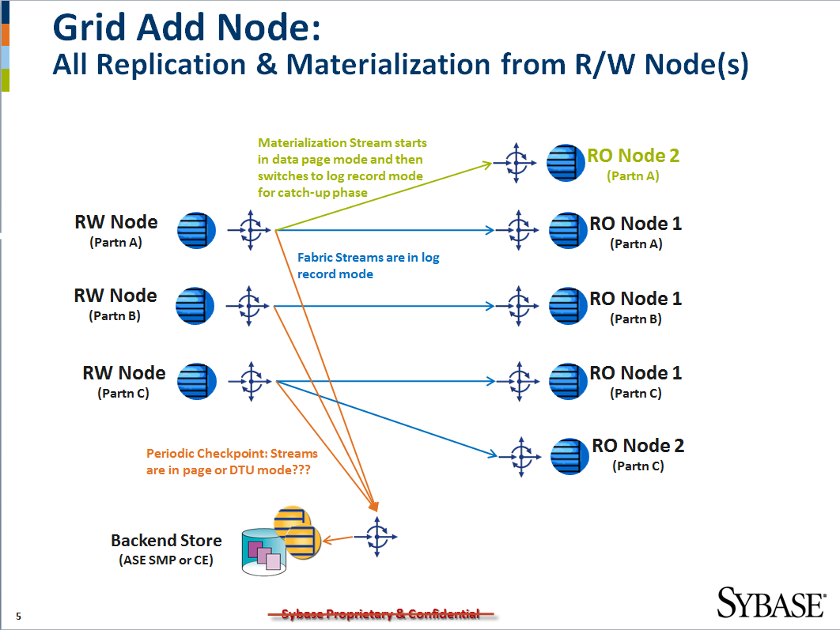
We did look at this….ASE DataGrid Project
True SDC Scalability Requires
Processing scalability
Data duplication + Workload partitioning/distribution
Memory scalability
Data partitioning + distributed query processing
ASE Grid Edition (then-SY Project)
ASE/CE follow-on for horizontal scaling
Data fabric with partitioned & read-only copies
In-memory runtime with persistence
Sounds like HANA doesn’t it???
…so then why bother scaling ASE??

Slide 21





ASE w/ HADR
Virtual Cluster
Planned for ASE 16.0 sp02 (Q3 2015)(in beta now)
To be certified with Business Suite
Integrated management with DBA Cockpit
Key Availability Features
Zero Data Loss w/ minimal impact on application
Standby site is controlled read-only
Automatic client failover (ala ASE/HA & ASE/CE)
Zero Downtime DBMS maintenance
Including major versions (not just patches)
Supports both HA & DR
HA with Synchronous Rep Agent for Zero Data Loss
DR with Asynchronous Replication for longer distances (>30km)
Fault Monitor
RMA

Slide 22





Comparing the Availability Options
HADR Capability | ASE/HA | ASE/CE | RS/WS or RS/MSA | ASE 16.x Always-On
Short distance HA (Zero Data Loss) | Single Copy | Single Copy
Long distance DR
N+1 or N+M Availability
Failover Speed (Recovery Time Objective) | 1-5min | <1-2 min | 10-30min | 2-5min
Workload Management/Logical Clusters
Automated Client Failover
Automated Fault Detection
Automated Materialization/ReSync | Single Copy | Single Copy
Minimizes Planned Downtime
Multiple Standby Support | Single Copy | Single Copy
Zero Downtime DBMS maintenance
Planned

Slide 23
Simplifying it
Use ASE Cluster Edition when
Fastest possible failover is necessary (RTO within seconds)
Multiple applications on multiple hosts need workload management for hardware optimization
Reduce HW acquisition costs via N+1 availability & workload management
Protect from hardware failures within the datacenter
Use ASE Always On (HADR) when
RTO can be within a few minutes
Zero data loss is required – even for data center failure or disk corruptions/storage failures
Maximum protection – zero downtime major upgrades, etc.
Workload (reporting) offload
Leverage HA resources to avoid sunk costs capitalizing standby hardware
Use legacy solutions (HA & RS WS/MSA)
Older ASE versions
Maximum availability/protection not as critical
Fully automated solution not necessary (manual failover/recovery)

Slide 24


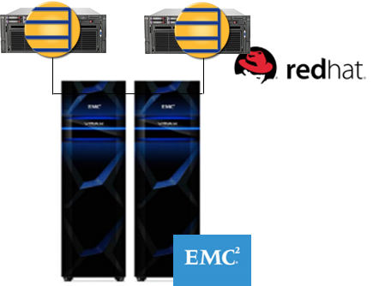
The MUNI Center (TMC) Bonds
4.5 million
Core transactions per hour
FX Trading Platform
>500 trading partners
29% of interdealer municipal bond market
12% of corporate interdealer bond market
4.5 million transactions per hour
Goal
Minimize downtime while managing rapid growth
Ensure in-house white label brokerage applications run without interruption
Exceed regulators mandates for disaster recovery (DR) and high availability
Solution
ASE Cluster Edition on RedHat Enterprise Linux w/ EMC VMAX storage
SAP Replication Server for reduced DR failover time
89%
Annual increase in trading volume
2-3 sec
For system failover, down from up to one hour

Slide 25
ASE CE 15.7 New Features
What new features were introduced in ASE Cluster Edition 15.7 sp130

Slide 26
ASE CE 15.7 sp130 features – Cluster Locking
2 New Configuration Parameters
Enable lock remastering
In previous releases, if a node failed over, the locks would be remastered.
If the failed node was restarted and the workload migrated back, the locks remained mastered on the remote node causing performance degradation when acquiring locks
In sp130+, locks can be remastered on the local (recovered) node
Physical lock cushion
When performing cache synchronization, ASE has to use physical locks on the pages in memory
Under high volume periods of a lot of cache transfers, ASE CE could run out of physical locks
In sp130+, you can specify a ratio that is used for setting aside physical locks

Slide 27
ASE CE 15.7 sp130 features – Single Instance Database (SIDB)
Single Instance Database
Creates an ASE CE database that is only visible from a single node
This avoids much of the cluster overhead such as cluster lock manager
This overhead was as much as 20% degradation as compared to ASE/EE on SMP
ASE CE SIDB now has ~same performance as ASE/EE on SMP
SIDB can be relocated to other CE nodes, etc. for load balancing, failover, etc.
Impact on Recovery
Normally, database recovery on CE is much faster than even ASE/HA as only the pages in doubt need to be recovered
A SIDB needs to undergo full database recovery much the same as ASE/HA

Slide 28
ASE CE Rolling Upgrades
Similar to competitive offerings, allow ASE CE to be patched with minimal or zero downtime
Introduced in ASE 15.7 CE sp134 (May 2015)
Similar to competition, there are 3 ways of achieving this
Rolling upgrades
Patches and/or minor upgrades that are certified as rolling upgraded compatible can be applied using a rolling upgrade approach.
In order to be certified, the patch must not affect
System table schema
Cluster interconnect infrastructure
Similar aspects that could cause one node to misbehave with respect to other nodes
Minimal down-time
Available with any CE version
Leverages LC failover and multiple nodes to mask the software installation time
Downtime is minimized to startup of upgraded nodes
Zero Down-time
Leverages replicated copy

Slide 29
ASE CE Roadmap
What new features we are considering for the next release and beyond

Slide 30
Legal Disclaimer
The information in this presentation is confidential and proprietary to SAP and may not be disclosed without the permission of SAP. This presentation is not subject to your license agreement or any other service or subscription agreement with SAP. SAP has no obligation to pursue any course of business outlined in this document or any related presentation, or to develop or release any functionality mentioned therein. This document, or any related presentation and SAP's strategy and possible future developments, products and or platforms directions and functionality are all subject to change and may be changed by SAP at any time for any reason without notice. The information in this document is not a commitment, promise or legal obligation to deliver any material, code or functionality. This document is provided without a warranty of any kind, either express or implied, including but not limited to, the implied warranties of merchantability, fitness for a particular purpose, or non-infringement. This document is for informational purposes and may not be incorporated into a contract. SAP assumes no responsibility for errors or omissions in this document, except if such damages were caused by SAP´s willful misconduct or gross negligence.
All forward-looking statements are subject to various risks and uncertainties that could cause actual results to differ materially from expectations. Readers are cautioned not to place undue reliance on these forward-looking statements, which speak only as of their dates, and they should not be relied upon in making purchasing decisions.

Slide 31
A quick primer on SAP roadmaps
SAP corporate standard for roadmaps
Only available to customers (e.g. Service Market Place)
Divided into Today/Planned/Future with high level only referring to high level ‘themed’ functionality
Today
Available or imminently available
Planned
Currently under development with expected delivery within 12 months
Functionality is committed
Future
Projects under consideration for >12 months (likely 18+ months)
Engineering may be working on effort (pilots/proof of concepts, research, etc.)
Essentially, goals for development - feature delivery undecided pending outcome of initial efforts
Typically a way of phasing in larger projects to big for a single release

Slide 32
ASE Cluster Edition Product road map overview - key themes and capabilities
Match SMP Performance
Single Instance Database (SIDB)
Cluster locking optimizations
Continuous Availability
Rolling patch upgrades (sp133)
ASE 16 Cluster Readiness
ASE CE 16 release (ASE 16 SMP sp01 level compatibility)
Improved Failover Speed
ODBC/JDBC Driver enhancements
Runtime performance enhancements (Phase 1)
Reduce CIPC overhead
RDMA support
Easier deployment
Virtualization support
Cluster file system support
ASE 16 Cluster Readiness
ASE 16 sp02 features
Support in-memory row cache
MVCC
SAP Applications on ASE CE
Business Suite certified on ASE/CE
Easier deployment
Unified CE & SMP codeline (single binary)
Non-Stop Availability
Metro-Cluster support
CI Replication (HADR for ASE/CE)
Single unified CE + HADR driver
(Release 15.7 sp13x)
This is the current state of planning and may be changed by SAP at any time.

Slide 33
ASE Cluster Edition Product road map overview - key themes and capabilities
Match SMP Performance
Single Instance Database (SIDB)
Cluster locking optimizations
Continuous Availability
Rolling patch upgrades (sp133)
ASE 16 Cluster Readiness
ASE CE 16 release (ASE 16 SMP sp01 level compatibility)
Improved Failover Speed
ODBC/JDBC Driver enhancements
Runtime performance enhancements (Phase 1)
Reduce CIPC overhead
RDMA support
Easier deployment
Virtualization support
Cluster file system support
ASE 16 Cluster Readiness
ASE 16 sp02 features
Support in-memory row cache
MVCC
SAP Applications on ASE CE
Business Suite certified on ASE/CE
Easier deployment
Unified CE & SMP codeline (single binary)
Non-Stop Availability
Metro-Cluster Support
CI Replication (HADR for ASE/CE)
Single unified CE + HADR driver
(Release 15.7 sp13x)
This is the current state of planning and may be changed by SAP at any time.

Slide 34
ASE CE 16
What does ASE 16 sp01 feature level mean
Remember, ASE 16 was released prior to ASE 15.7 sp130
Quiesce-less disk snapshot backups
Some new features were added to ASE 15.7 sp130+
These were rolled into ASE 16 sp01 along with some additional new features
ASE CE 16 w/ sp01 features
Brings the SMP scaling to CE (allows larger nodes)
Adds the new 16 features such as index compression, database encryption
Retains the 15.7 sp130 enhancements
…but won’t have the ASE 16 sp02 “Corona” features
HADR, Capture replay, transactional memory, etc.

Slide 35
RDMA & CIPC Performance
One of the big bottlenecks in ASE CE is the Cluster Interconnect
This the dedicated intra-node communications to support
Cluster locking
Logical locks
Physical locks
Page cache synchronization
Cluster heartbeat
Multiple NIC’s recommended
One CIPC interconnect handles cluster locking
Other CIPC handles page cache synchronization
ASE CE CIPC
ASE CE 15.7 only supported packet based communications (e.g. TCP/IP)
Requires significant OS and interface tuning
Overhead of packet framing in both memory and time (latency)
Lower interface speeds (PCI – 10Gbps)
ASE CE 16 planned support for RDMA/Infiniband
Remote Direct Memory Access – much faster/lower latency (10’s of μsecs vs. 10’s of ms)
Higher bandwidth 40Gbps+ (PCIe)

Slide 36
ASE Cluster Edition Product road map overview - key themes and capabilities
Match SMP Performance
Single Instance Database (SIDB)
Cluster locking optimizations
Continuous Availability
Rolling patch upgrades (sp133)
ASE 16 Cluster Readiness
ASE CE 16 release (ASE 16 SMP sp01 level compatibility)
Improved Failover Speed
ODBC/JDBC Driver enhancements
Runtime performance enhancements (Phase 1)
Reduce CIPC overhead
RDMA support
Easier deployment
Virtualization support
Cluster file system support
ASE 16 Cluster Readiness
ASE 16 sp02 features
Support in-memory row cache
MVCC
SAP Applications on ASE CE
Business Suite certified on ASE/CE
Easier deployment
Unified CE & SMP codeline (single binary)
Non-Stop Availability
Metro-Cluster Support
CI Replication (HADR for ASE/CE)
Single unified CE + HADR driver
(Release 15.7 sp13x)
This is the current state of planning and may be changed by SAP at any time.

Slide 37
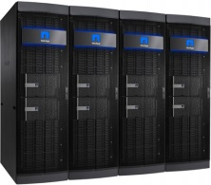
Understanding Storage Stretch/Metro Clusters
In both cases
It should appear to OS as a single SAN
Application transparency to SAN is impossible otherwise
Active/Active
Writes from any node can occur on any side
Reads and writes are both local normally
If local SAN fails, reads/writes redirected to remote
Commonly the most thought of
Likely not supported by all SAN vendors
Active/Standby
All writes are done to a single primary SAN
Reads optionally can be done on local SAN
Remote node writes are typically slower (double WAN cost)
If primary fails, standby takes over transparently
Most likely supported by SAN vendor
Active/Active
Active
Standby

Slide 38
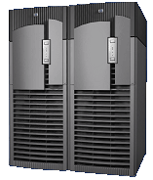


Metro Cluster Thinking & Considerations
Storage Metro Clusters for DBMS Clustering
IO Fencing support must work across SAN nodes/distance
App only sees single SAN – SAN needs to handle appropriately (distribute or failover)
May be simplified if using Cluster File System with IO fencing support
SAN Write Cache must maintain write serialization across SAN nodes
SAN synchronous cache mirroring
SAN fully bi-directional synchronous disk replication
ASE CE will likely a phased approach
Phase 1 – support for metro cluster hardware implementations
Phase 2 – DBMS cluster optimizations (not yet on roadmap)
DBMS Cluster Optimizations for Storage Metro Clusters
Failover tiering (local then remote)
Cluster locking optimization
E.g. cluster locking may optimize that lock masters are local to site
if failover within site, only recovery of inflight transactions (instantaneous failover)
If site failure and database recovered at remote facility, full database recovery ala SIDB
Workload optimization
Only nodes in the same site can share access to the same database
Minimize page cache transfers to within site
DBMS Page Cache Synchronization
Distributed IO Fencing
SAN Synchronous Cache Synchronization
SAN Active/Active Synchronous Disk Replication

Slide 39
ASE Cluster Edition Product road map overview - key themes and capabilities
Match SMP Performance
Single Instance Database (SIDB)
Cluster locking optimizations
Continuous Availability
Rolling patch upgrades (sp133)
ASE 16 Cluster Readiness
ASE CE 16 release (ASE 16 SMP sp01 level compatibility)
Improved Failover Speed
ODBC/JDBC Driver enhancements
Runtime performance enhancements (Phase 1)
Reduce CIPC overhead
RDMA support
Easier deployment
Virtualization support
Cluster file system support
ASE 16 Cluster Readiness
ASE 16 sp02 features
Support in-memory row cache
MVCC
SAP Applications on ASE CE
Business Suite certified on ASE/CE
Easier deployment
Unified CE & SMP codeline (single binary)
Non-Stop Availability
Metro-Cluster support
CI Replication (HADR for ASE/CE)
Single unified CE + HADR driver
(Release 15.7 sp13x)
This is the current state of planning and may be changed by SAP at any time.

Slide 40
ASE 16
The fun began….a year ago

Slide 41
The past: ASE 15.7 sp100+ Operational Catchup
ASE 15.7 → Plethora of SP’s
Rapid evolvement of product features for SAP ERP requirements
Bahrani code-line: sp 40, 50, 60 …. (2 digits)
Security enhancements, hash statistics, etc.
Carina code-line: sp 100, 110, 120, 130, … (3 digits)
ASE Carina (sp100+) added a lot of online features
Online index creation (no blocking)
Online reorgs (no blocking)
Quiesce-less disk snapshots for backups

Slide 42




Introducing SAP ASE 16 Extreme Transaction Performance
Scale
Scalability in the Cloud and on premise
Speed
High throughput & low latency at high core counts & users
Security
Complete data security & application resiliency
Simplicity
Tools, monitoring and diagnostics for easier management
Scale-up on large SMP systems
Partition-level locking
Locking & latching enhancements
Index compression
Query performance enhancements
Dynamic thread assignment
Full database encryption
Residual data removal
Synchronous replication for disaster recovery
Multi-trigger support
Support “Create or Replace” command for database objects
Enhanced monitoring & tool support
Notes:
Note: Lazy decompression is now a 2015 feature - removed

Slide 43



Remember this picture???
Operating System
Engine 0
Engine 1
Engine N
Registers
File Descriptors
Registers
File Descriptors
Registers
File Descriptors
2
5
…
1
Running
Running
Running
Kernel
Shared Executable (Program Memory)
Shared Memory
Hash
Proc Cache
Run Queues
Sleep
Queue
Lock Chains
EC1
4
lock
sleep
6
3
EC2
7
disk
I/O
Pending I/Os
EC2
D
I
S
K
N
E
T
N
E
T
Other Memory
8
send
sleep
EC3

Slide 44
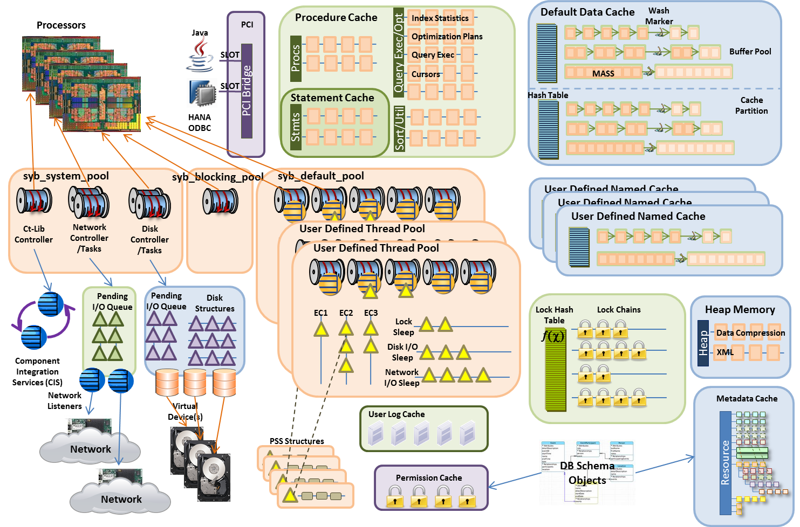

….New & Improved – Literally and Figuratively for ASE 16

Slide 45
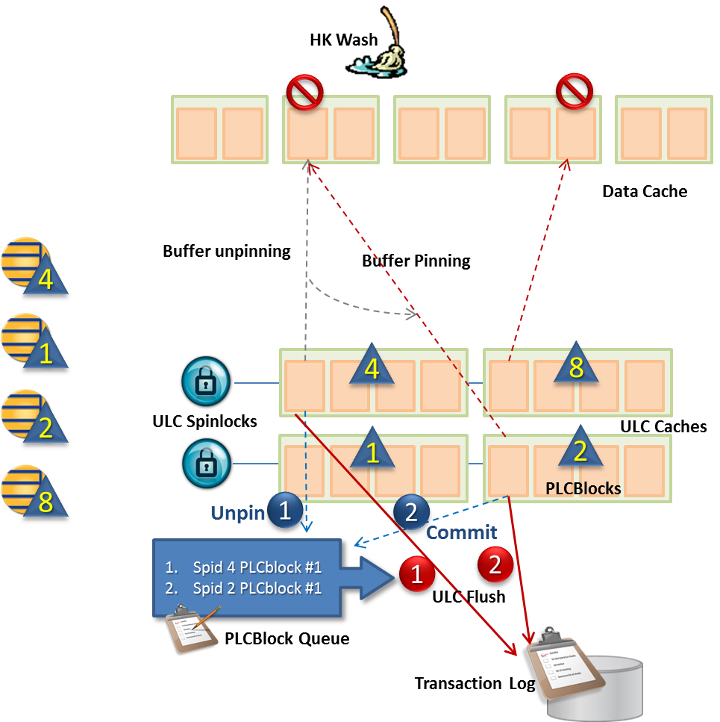
Buffer Unpin → Log Contention
Buffer Unpin Scalability Bottleneck
Frequent modifications to same datarows locked page (or index page for datapages) resulted in high contention on log semaphore
Think inserts on datarows locked heap table
Result was it essentially undid all the optimization that ULC provided
ASE 16 Solution: ULC Queue
PLCBLOCKS
Each ULC now has 4+ page size PLCBLOCKS
PLCBLOCK QUEUE aka ULC Queue
Each database has a queue of PLCBLOCKS to be flushed to the log
As each PLCBLOCK is full or unpinned, it is added to the queue (simply a list)
When any txn commits, all PLCBLOCKS in the queue are flushed to disk

Slide 46
Data & Index Compression – A Primer
All common OLTP database compress the same way
Columnar data is compressed using dictionary compression/tokenization
LOB data is compressed using Zlib, etc. compression
Other vendors will discuss “advantages” of their compression….nothing is free
Table-level tokenization (vs. page level ) – e.g. DB2 UDB (and SAP IQ)
Problem: some columns will be higher cardinality requiring larger token space/less compression
Problem2: larger token space → slower compression/decompression (or more CPU/memory)
Problem3: some like DB2 only updated on table reorgs
Multi-stage compression (dictionary + prefix) – e.g. MSSQL
Problem: decompression takes multiple stages as well → slower data access
Contiguous row tokenization (e.g. Oracle)
Problem: update to change a value in one row requires re-tokenization of all rows (escalated write conflicts)
Hybrid columnar compression (e.g. Oracle)
Only works on Exadata and even then only on data that is bulkloaded.

Slide 47

Data & Index Compression in ASE
Compression Levels
Enabled/disabled at the database, individually per table, or column level
SAP by default enables compression at the database level
However, known volatile tables such as queue tables are uncompressed
Different partitions in same table can have different compression
Current data partition → uncompressed
Previous/old partitions → page compressed
ASE Data Compression (ASE 15.7):
Data compression with industry standard dictionary compression
Leverages index leaf nodes, etc. to avoid decompressing data values to reduce impact on applications
SRS replicates compressed LOB data to standby databases in compressed form, but decompresses for non-standby systems
ASE Index Compression:
Intermediate nodes use suffix compression (and has since v11.9.2)
Leaf nodes use prefix compression (16.0+)
Maximizes compression while minimizing the number of compression operations to reduce impact
Typical ERP implementation on ASE is 30% smaller than Oracle

Slide 48
Jeff’s Advice on Compression
Don’t compress small tables
Anything under 60MB will likely be more work than gain
Don’t compress frequently accessed tables/partitions
For large tables, consider partitioning
Historical → compressed; Last year → compressed; This year → uncompressed
If frequently in cache – don’t compress (e.g. customers)
Or compress infrequent read columns
E.g. fname, lname, customer_id → uncompressed; address → compressed
Don’t compress Pkey/Fkey indexes (or used frequently for joins)
Compress indexes that are rarely used (monOpenObjectActivity UsedCount)

Slide 49
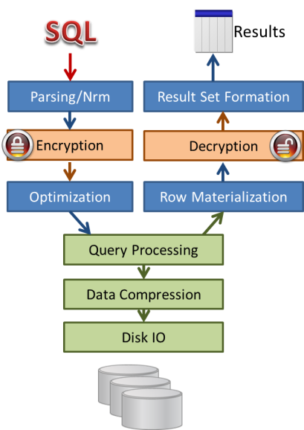
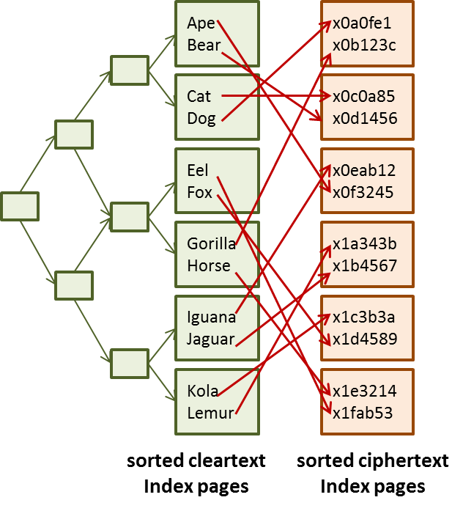
Column Encryption in ASE
Column Encryption (ASE 12.5.4 and later)
Totally secure – encrypted on disk, in memory, in log, etc…..
Each column can be encrypted with separate keys
Assumes different users with different access requirements
Prevents inadvertent disclosure to authorized users of system but not authorized for data – including DBA if desired
Column decrypt permission with data masking (unique to ASE)
e.g. ###-##-####
Impacts on performance
Good news: Indexable encryption for Pkey and Fkey columns
Bad news:
Range queries (due to ciphertext sorting)
Blocks compression effectiveness (if a SALT/IV is used)
Certified with SAP applications….but….
Only provides disk level protection as SAP uses common login
Hands-down better column encryption than competition (Oracle, MSSQL)

Slide 50
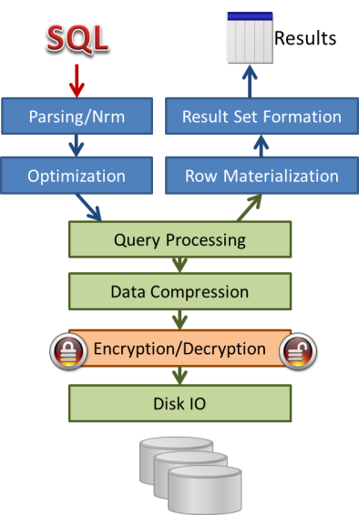
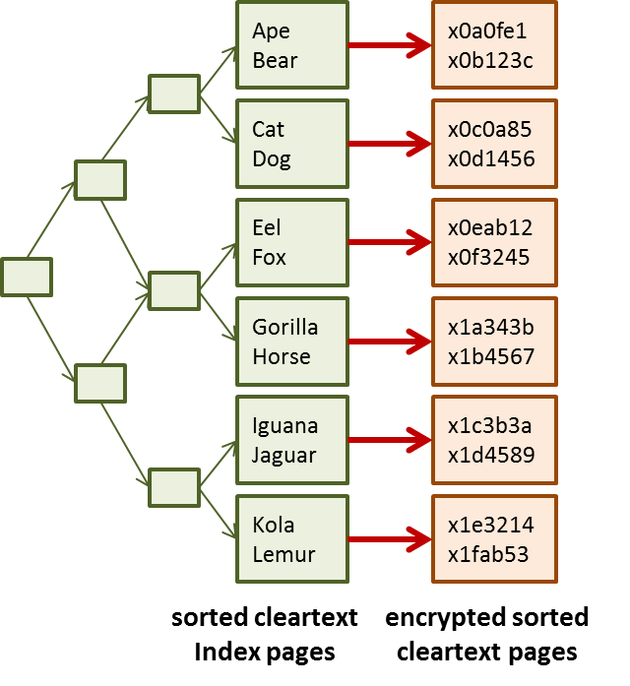
Data Encryption in ASE 16
Column Encryption still supported
…and can be used in conjunction with Full Database Encryption
Full Database Encryption (new in ASE 16)
Provides protection for an entire database, WITHOUT affecting existing applications
All data, indexes, and transaction logs in database are encrypted
Backed up database in encrypted form
All authorized database users can see data
No impact on range queries or compression
Encryption is at page level
as pages are written to disk, and decryption before they are loaded into memory
Will be after/before Compression/Decompression
Dual key control with automatic startup
Can be implemented online w/ user impact
Can be suspended/resumed for long run times

Slide 51



ASE Data Encryption/Data Security vs. MS SQL
Data Security Feature | ASE 16 | MS SQL 2014
Transparent full database encryption
Column encryption
Transparent column encryption (usable by SAP/older apps, etc.)
Decrypt permission on encrypted columns
Dynamic masking of cipher text on encrypted columns
Encrypted cols in indexes/joins
DBA can be prohibited from viewing encrypted column data
Dual key control
Export encrypted data
Row level access (using UDF or ACF)
Granular permissions (grant with where clause)

Slide 52

ASE PCI Bridge to HANA
Support distributed queries with HANA data
Steps to using
Install HANA client package on ASE machine
Add HANAODBC server class
sp_addserver logical_name HANAODBC phy_name
Add external login to HANA
sp_addexternlogin logical_name sa HANA_login HANA_password
Create proxy table
New server class “HANAODBC” added for connection to HANA backends
Data type mapping from HANA to ASE done automatically
ODBC interface will co-exist with the CTLIB interface
Query Engine
CTLib Interface
CTLib Access Method
SQL Transform
Datatype Mapping
ODBC Interfcace
Local Access Method
ODBC Access Method
HANA ODBC Driver
This is the framework used to build ASE 16’s sp02 Accelerator for ASE (A4A)

Slide 53
ASE 16 sp01 (“BW”)
Improvements in partitioning and parallel query optimization

Slide 54
Something interesting happened on the way to the office…
As we said, the goal for ASE & SAP ECC is to be the fastest, while having low TCO
The original goal for SAP BW on ASE was to match MS SQL Server performance
Rationale in one word: “HANA”
High end customers (e.g. large Oracle) → HANA
It was assumed that this would be business value play
Low end customers (e.g. MS SQL) → ASE
It was assumed that this would be more of a TCO play
…but then that funny thing happened…
The preponderance of migrations have been off of Oracle
as well as a considerable number from MS SQL
As expected, especially for BW, many of these migrated to HANA
However….a lot of them migrated to ASE instead
Suspect the sticker shock of Oracle maintenance & HW costs pushed them into a TCO play

Slide 55
ASE 15.7 had a number of issues with running BW systems
Partitioning was designed for OLTP
A lot of the complex partitioning requirements for DSS have slower operations
ASE chose to use a partitioning implementation more aligned with OLTP
There were other issues that ASE engineering just didn’t have time to get around to previously
E.g. partition level locking
This resulted in a number of problems
High number of range partitions in BW systems didn’t work in ASE
Parallel index creation didn’t work as desired
Query Optimizer wasn’t really tuned for highly partitioned tables
Query plan generation was slow on highly partitioned tables
Parallel query/sorting wasn’t always employed when it would be useful
Static thread assignment limited the number of concurrent parallel queries
Inherent limits on number of tables/worktables in a query
One of the core issues was ASE 15.7’s optimizer had issues identifying the fact table
Under allrows_dss, ASE would try to recognize the fact table in a star schema query
One of the key strategies is to use a Cartesian of the dimensions and hash join to fact table

Slide 56
The fixing really started in ASE 16.0 (GA)
Yes, there were a lot of scale-up/XOLTP features
XOLTP is a focus of ASE, so that should be no surprise that any release would have some features
….but there were a ton of DSS related enhancements
Relaxed some of the query limits
Increased the number of tables in a query from 50 → 250
Columns in order by increased from 31 → 400
Improved star join/star schema query processing
Implement bloom filtering
Added fact table optimization hint
Improved parallel sorts & parallel hash joins
Dynamic thread assignment for parallel query execution
Allows more parallel queries to execute concurrently
This set the stage for ASE 16 sp01

Slide 57
ASE 16 sp01 “BW”
Focus for ASE 16 sp01 was almost exclusively SAP BW
A few odd features for custom/OLTP
Hyper-partitions
Support for 1000’s (4000+) of partitions using range partitions with minimal performance hit
Build index by partition
Faster parallel online create index
Improved parallel query
Parallel optimization improvements for partitioned tables
Extends queries considered for parallelism & maximize parallelism
3-5x faster compilation time on partitioned tables
Reduce memory usage
(Nearly) no query performance degradation for hyper-partitioned tables
Other optimizations
Increased query limits
Improved proc cache optimizations

Slide 58
Customer Results with early drops of ASE 16 sp01
ASE Engineering worked with a small set of customers with huge issues on 15.7
Those customers were given early drops of ASE 16 sp01 to vet the fixes/enhancements
Those customers are either now in production on ASE 16 sp01 or very shortly will be
One or two were waiting for pl01 which fixed a late query issue that predated even 15.7
It is strongly recommended that any BW on ASE customer upgrade to ASE 16 sp01 pl01+
This is based on the experiences of these customers
The next slides show some of the results at these customers or internal tests
We are not allowed to identify the competitive DBMS due to legal reasons
So, you will see it discussed as “Any DB”
However, it is one of the major vendors (actually more than one are involved)

Slide 59
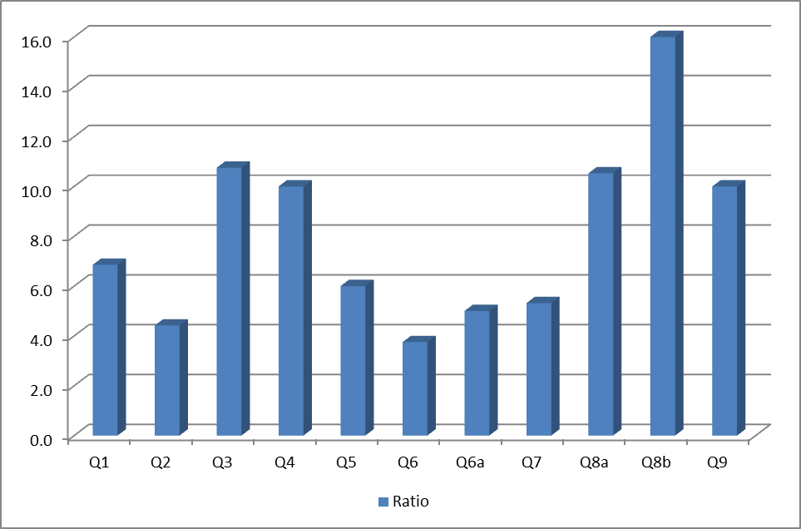
BW Report Performance – general observation (2) Performance improvement ratio of ASE-16 to Any DB

Slide 60
BW Performance Comparison @ Customer 4

Slide 61
Internal: Hyper partitioning support: query compilation time
Query compilation time seconds/partitions on the batch of 16 various queries
On high partitioned tables (> 1000 partitions) we use in average 16-18% of the initial time.

Slide 62

BW ASE Implementation with NLS SAP IQ (DBSL based solution)
BW
BW Porting
InfoProvider
Nearline Adapter (ABAP based )
General Porting
DBSL for Sybase ASE (/w IQ ext.)
(Kernel based; Open SQL + Native IQ SQL via ADBC)
DB Client
NLS Interface
ODBC Driver from IQ
SAP ASE
SAP IQ

Slide 63
SAP ASE Roadmap & Direction
Plans for ASE in general and considerations for SAP Applications running on ASE

Slide 64
Legal Disclaimer
The information in this presentation is confidential and proprietary to SAP and may not be disclosed without the permission of SAP. This presentation is not subject to your license agreement or any other service or subscription agreement with SAP. SAP has no obligation to pursue any course of business outlined in this document or any related presentation, or to develop or release any functionality mentioned therein. This document, or any related presentation and SAP's strategy and possible future developments, products and or platforms directions and functionality are all subject to change and may be changed by SAP at any time for any reason without notice. The information in this document is not a commitment, promise or legal obligation to deliver any material, code or functionality. This document is provided without a warranty of any kind, either express or implied, including but not limited to, the implied warranties of merchantability, fitness for a particular purpose, or non-infringement. This document is for informational purposes and may not be incorporated into a contract. SAP assumes no responsibility for errors or omissions in this document, except if such damages were caused by SAP´s willful misconduct or gross negligence.
All forward-looking statements are subject to various risks and uncertainties that could cause actual results to differ materially from expectations. Readers are cautioned not to place undue reliance on these forward-looking statements, which speak only as of their dates, and they should not be relied upon in making purchasing decisions.

Slide 65

Bringing XOLTP to the next level with SAP ASE 16 SP02
SAP ASE 16
Acceleration
Leverage in-memory computing and intelligent data placement
2014
Speed
Security
Scale
Simplicity
2015
Acceleration
Availability
Agility
Availability
Unify HA/DR architecture and enhance clustering edition
Agility
Embrace cloud deployment and leverage workload intelligence
Notes:
ASE 16.0 released in April 2014 focused on:
Scale - eliminating resource contention and improving concurrency so that the power of large SMPs servers can be fully used to support millions of user and machine-to-machine transactions on large volumes of data
Speed - returning results to users faster by reducing disk I/O operations and optimizing query execution
Security - protecting the privacy of data without interfering with system performance, and ensuring that businesses never experience data loss even in the case of a disaster
Simplicity - lowering the cost of administering ASE deployments, no matter the size; and reducing development costs by allowing business applications to manipulate all kinds of data without modifying their source code.
ASE in 2015 builds on the foundation with:
Acceleration – leveraging in-memory computing to reduce latency and increase throughput
Availability – Guaranteeing data and transaction availability and minimizing planned and unplanned downtime
Agility – streamlining operations, reducing costs, and enabling innovation

Slide 66


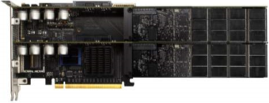
SAP ASE 16 Development Architecture
O-DATA
ODBC
JDBC
T/SQL
Scripts
XOLTP Query Processing
Simplified Native Access Plans
aka compiled query
Latch-free B-Tree on Indexes
Lockless Buffer Manager
Analytics
Hyper-partitioning & Dynamic Threading
Enhanced Parallel Query (BW)
HANA Accelerated Reporting (A4A)
Hardware Exploitation
CPU atomic instructions
CPU Transactional Memory (TSX)
SSD buffer extensions
Data Store Access Mgmt (Heatmap)
aka Dynamic Tiering
Analytics QP
XOLTP QP
Stored Reports
Parallel
Code Compile
Dynamic Threading
CDS/SQL
Main Memory
Lockless Access
A4A
In-memory Row Store (MVCC)
Flash Memory
Lockless Metadata
Transactional Memory (TSX)
Lock Optimizations
Buffer Cache
Kernel Threading
Direct
Interface to HANA
Txn Log Optimizations
Data Encryption & Compression
Data Store Access Mgmt
SSD Buffer Extension
HANA
Disk
Available
Upcoming sp02
Upcoming sp03

Slide 67
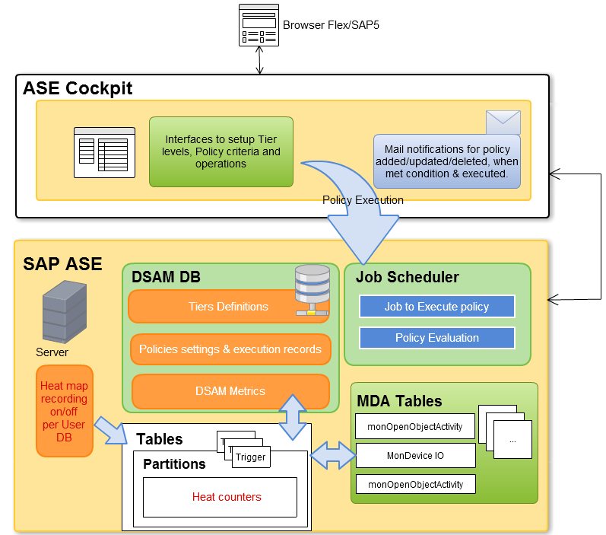
Data Store Access Management (Heat Map) - Architecture
DSAM
A new configuration in ASE to enable/disable DSAM.
Server tracks metrics partition, segment and device levels.
Policy DB stores tiers, policy definition and history.
Policy Evaluation will be carried out as per defined schedule
Not an option itself…
To be bundled with compression, memscale, etc.

Slide 68
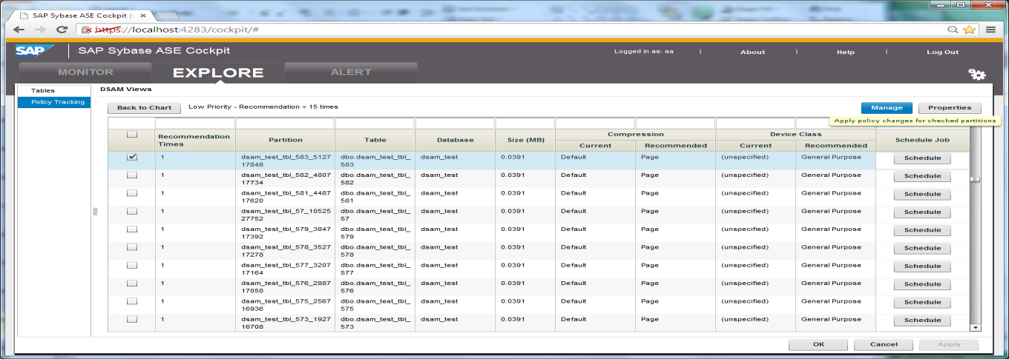
Viewing Partitions That Do Not Meet Policy Conditions
Partition name, table, database, size, current and recommended compression, current and recommended device class, and whether the execution is scheduled.
To move a partition to a specified segment and compress it, checked the partition and click Manage.
alter table table_name move partition partition_name to destination_segment_name

Slide 69



Acceleration Enabling mixed workload performance
SAP HANA accelerator for SAP ASE
Enabling advanced analytics on SAP ASE data
Feature
Data federation from SAP ASE to HANA vice versa
Replication from SAP ASE into SAP HANA
Integrated SAP HANA/ASE installation and management
Continuous enhancements with upcoming SAP HANA releases
Benefits
Combine XOLTP and fast analytics on SAP ASE data
ASE App
ASE App
OLTP
Query
OLTP
Query
ASE
Query
ASE
* Feature available Q4 2015
Notes:
Data federation from SAP ASE to HANA and from SAP HANA to ASE
Replication from SAP ASE into SAP HANA
Integrated SAP HANA/ASE installation and management Integrated installation and Admin, Single configuration management, HANA Studio support for SAP ASE (for monitoring only)

Slide 70
SQL Enhancements/SAP CDS Support
ASE 16 sp02
Table variables
Global temp tables
Table level UDF
ASP 16 sp03 → SAP CDS Phase 2
Needed for Business Suite 2016
Also used by SAP “Simple” Apps
SAP CDS Phases 3 & 4 expected in future
declare @author_lookup table
(au_id varchar(11),
title_id varchar(6),
au_lname varchar(40),
au_fname varchar(20))
insert into @author_lookup
select a.au_id, ta.title_id, a.au_lname, a.au_fname
from authors a, titleauthor ta
where a.au_id=ta.au_id

Slide 71
Always On Option
HADR

Slide 72
ASE w/ HADR
Virtual Cluster
Planned for ASE 16.0 sp02 (Q3 2015)
To be certified with Business Suite
Integrated management with DBA Cockpit
Key Availability Features
Zero Data Loss w/ minimal impact on application
Standby site is controlled read-only
Automatic client failover (ala ASE/HA & ASE/CE)
Zero Downtime DBMS maintenance
Including major versions (not just patches)
Supports both HA & DR
HA with Synchronous Rep Agent for Zero Data Loss
DR with Asynchronous Replication for longer distances (>30km)
Fault Monitor
RMA

Slide 73
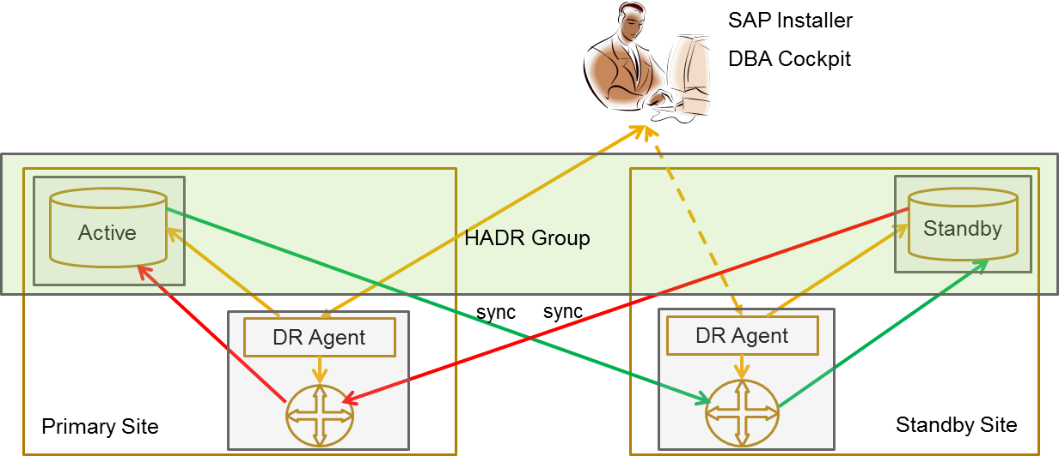
Landscape used for HADR latency tests
OS: SUSE 11.2
CPU: 4 socket, 32 cores, 64 threads, Intel, 2700 MHz
Memory: 512 GB
OS: SUSE 11.2
CPU: 4 socket, 32 cores, 64 threads, Intel, 2700 MHz
Memory: 512 GB
SSDs used for SPQ, ASE log devices and SRS stable queues

Slide 74
HADR Tuning
Server | CPU | Memory
Primary Dataserver | 16 cores (# of engines) | 20 GB (max memory) 20 GB used
Primary SRS | No max limit | 15 GB (memory limit) – not used unless there is a failover
Replicate SRS | No max limit Avg 8 cores used | 10 GB (memory limit) 12 GB used
Replicate Dataserver | 16 cores (# of engines) | 20 GB (max memory) 20 GB used
SRS Tuning | Value
dsi_compile_enable (HVAR) | On
dsi_compile_max_cmds | 50000
dt_apply | 4
parallel_dist | On
dsi_num_threads (parallel DSI) | 5
cmd_direct_replicate | On
sqt_max_cache_size | 1G
rsi_batch_size | 128 MB
block_size | 256K
OS System Tuning
Setting of CPU governors to performance mode to run at max frequency
NUMA binding of SRS (cores and memory) to one NUMA node with 8 cores

Slide 75
Replication Throughput (Log GB/HR)
Latency:
As long as applications generate changed data at < 140 GB/HR, latency will be < 5s
Throughput:
With 140GB/HR, SRS can replicate changed data up to 3TB in a day
In our lab environment, to push 140 GB/HR throughput with SRS we needed 8 cores

Slide 76
Replication Throughput (cmds/sec)
Latency :
As long as applications generate changed data at < 75,000 cmds/sec, latency will be < 5s
Throughput:
With 75,000 cmds/sec, SRS can replicate changed data up to 3TB in a day

Slide 77
HADR performance summary: in-house Lab testing with two hosts in same Data Center
Performance measured in lab condition with two hosts in the same data center
140 GB/HR transaction log transfer rate
2 ms average latency for the log (sync replication) to be persisted by HA Services on the Companion site
< 5 seconds latency for the data to appear on the Companion ASE after applying the logs persisted by HA Services
< 15% average impact to the online transaction
Failover end-to-end in less than two minutes (as measured in lab environment)
Failover consists of 3 components
Failure Detection: under 3 seconds
Confirmation this is real failure, not a network glitch (configurable) : up to 1 minute 45 seconds
failover process: 10 to 15 seconds

Slide 78
ASE CE vs. HADR - A Different Viewpoint
HADR Capability | ASE/CE 15.7 | ASE/CE 15.7 w/ SIDB | ASE/CE 16.0 w/ SIDB | ASE 16.x Always-On
Availability Date | Available Now | Available Now | Q4’15/Q1’16 | Q3’15
Operational Complexity | Simple | Simple | Simple | More Complex
Recovery Time Objective | <1 min | 1-2min | 1-2 min | 2-5 min
Impact on application performance | Cluster locking | None | None | Sync Rep
Failure protection (HA level) | Host, DBMS instance | Host, DBMS instance | Host, DBMS instance | Host, DBMS, DB, Disk, Geo
Application Compatibility | Tempdb→#tempdb | Tempdb→#tempdb | Tempdb→#tempdb | Rep Compatible
Use 2nd node for R/O / Reporting | Yes w/ perf impact | No | No | Yes w/ no impact
Use 2nd node for R/W on 2nd DB | Yes | Yes | Yes | No
Support vertical scalability | No | No | Very limited | Yes + XOLTP
Development Goal | Fast Failover Workload Management N+1 Availability | SIDB to eliminate cluster overhead on single node | Move CE to 16.x Reduce CIPC overhead | Maximum Availability

Slide 79
MemScale Option
XOLTP, SSD Buffer Extension, Transactional Memory

Slide 80
SNAP (aka Compiled Queries)
Similar to a JIT for JAVA
Avoids repetitive query exec code generation from the physical operators output from query optimization
Works on
Cached SQL Statements in statement cache
Statements within stored procedures
Fully prepared SQL statements
Shortens code execution path
As soon as statement is identified, it simply loads the previously saved Query Execution Native Access Plan
Query identification
SQL Hash code found in statement cache
Subsequent exec of a statement in a stored proc
Subsequent exec of a fully prepared statement
Receive Buffer
TDSLANG → select * from table where due_dt =getdate() and recv_date is null
SQL Parsing
SELECT → {column list}
FROM → table
COND1 → due_dt <=getdate()
COND2 (AND) → recv_date is null
Normalization
Stored Procs,
Stmt Cache,
Prepared Stmts
SELECT → {column id’s & datatypes}
FROM → objid=123456
COND1 → col_id=3 (dt) >= (dt) ‘Jan 1 2015’
COND2 (AND) → col_id=4 (dt) IS NULL
Query Compilation
SNAP
Pre-Processing
Query Optimization
Native Access Plan (Query Exec Code)
Query Execution
Query Execution

Slide 81

Latch-free B-Trees
Latches added for DOL index pages
Prior to DOL locking (1998), ASE used locks on index pages – which were held the entire length of the transaction
These index locks were the single largest source of contention and deadlocks
Non-transactional Latches
With DOL tables, a process grabbed an non-transactional latch only long enough to read (shared-latch) or modify (exclusive-latch) that index page and then released it
In the nearly 2 decades (!) since, transaction volumes are now in the XOLTP range and these latches now cause the same level of contention as locks previously.
Latch-free B-tree
Index modifications are done in-memory using a delta merge process and CPU atomic instructions – eliminating latch usage for writes
Reads do not need latches at all

Slide 82
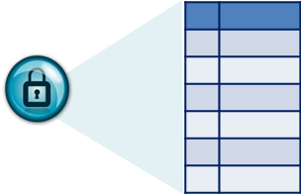

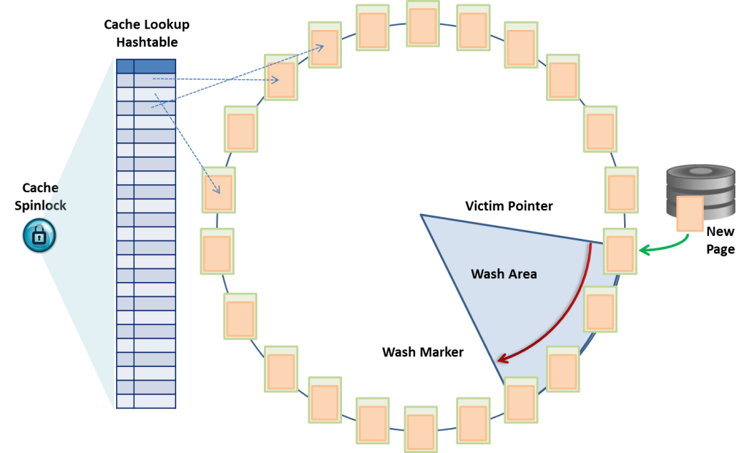
Lockless Buffer Manager
Cache spinlocks are grabbed …
Cache search to see if a page is in cache
Moving a page from LRU to MRU
Adding/removing a page to cache
Updating the buffer keep count
to prevent another query from flushing page from cache while trying to read it
Lockless Buffer Manager (new in 16 sp02)
Only applies to caches with ‘relaxed cache strategy’
Cache has to as larger or larger than tables bound
Uses atomic operations for buf keep count & cache hash table operations
Eliminates victim pointer/cache replacement
bufsearch()
Cachelet Spinlock
buftoMRU()
Update keepcnt

Slide 83
Benchmarking these 3 features
Two identical linux hosts in ASE engineering
80 cores & 512GB memory each
Each ASE configured identically – 80 engines, etc.
Host #1 (red lines in graphs) → ASE 16 sp01 (even better than ASE 15.7)
Host #2 (blue lines in graphs) → ASE 16 sp02 beta
The benchmark
Test is based on internal call center/case management system
Has similar profile to trading systems
Significant cache contention due to many users after the same data rows (e.g. current ticker prices)
Scales from 1000 to 5000 users

Slide 84
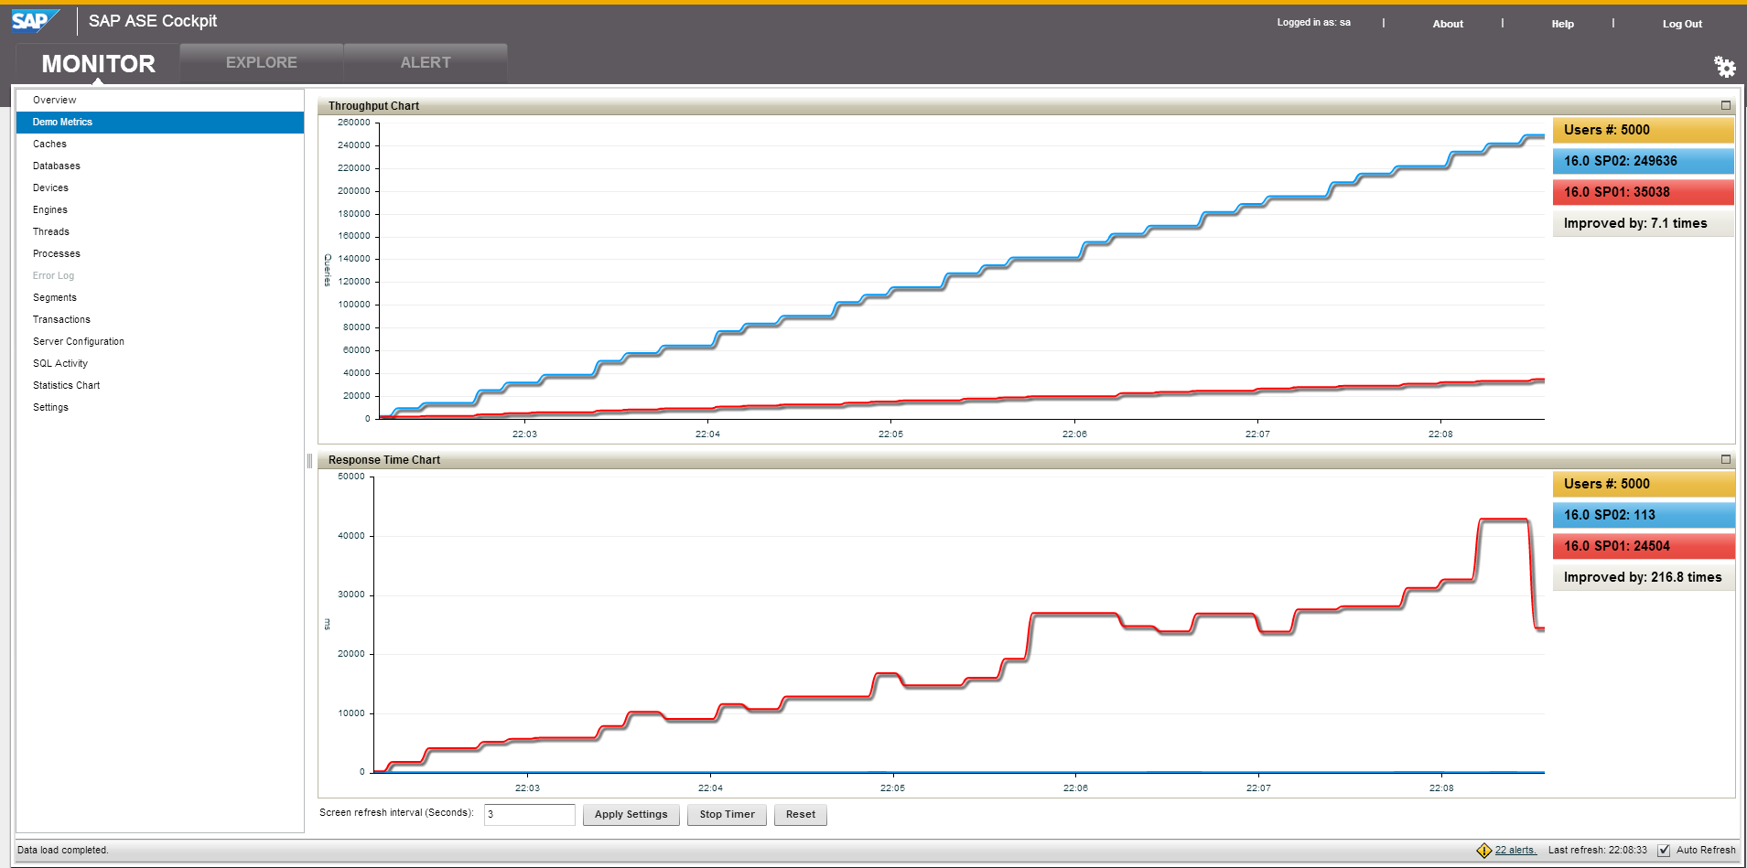
Benchmark Results
Notes:
Comment on the graph – in this case we see contention causing peaks and troughs (when contention isn’t occurring as much) in the response times for the ASE 16sp01 system. This is very common as contention can occur sporadically due to cpu timing.

Slide 85
Transactional Memory
Programming for concurrency has always required something like mutexes
Mutexes either can be spin (ASE spinlocks) or sleep (ASE does physical & logical locks to avoid these)
Mutexes have high overhead as they require the cpu to raise a memory barrier
Which means coordination with all the other cpu’s on the host….an expensive process on large core-count machines
CPU manufactures have started to address this problem by adding HW instructions
E.g. Test/set; compare and swap
Allows memory values such as counters (e.g. keep counts, etc.) to be modified without spinlocks – ASE 16
Transactional memory
Allows list contents to be changed without a spinlock
Transactional memory only available in recent CPU cores
X86/64 Haswell v2 (not v1)
IBM Power8, etc.

Slide 86
A common pain point with any DBMS
The miserable fact of life with large data volumes and analytical queries
Query execution often results in large work tables in tempdb
Huge impact on cache contents
Often spills to disk – typically a SAN on the other side of a [slow] HBA adapter
4-8Gbps, 250 concurrent IO’s, etc.
….which then fills SAN cache, which then spills to really, really slow disks
Query execution often requires scanning large data volumes
Again, impact on cache contents as other tables/pages used for other queries pushed out of cache
Typical drill-down and other subsequent queries on dimensions often hit the same pages
….but either couldn’t fit in cache….or were pushed out by another query
Typical solution → move entire database to SSD in SAN
Unfortunately, very expensive due to high cost of SSD in SAN
Doesn’t resolve the IO bottlenecking on HBA – especially for tempdb (work tables, sorts, etc.)

Slide 87
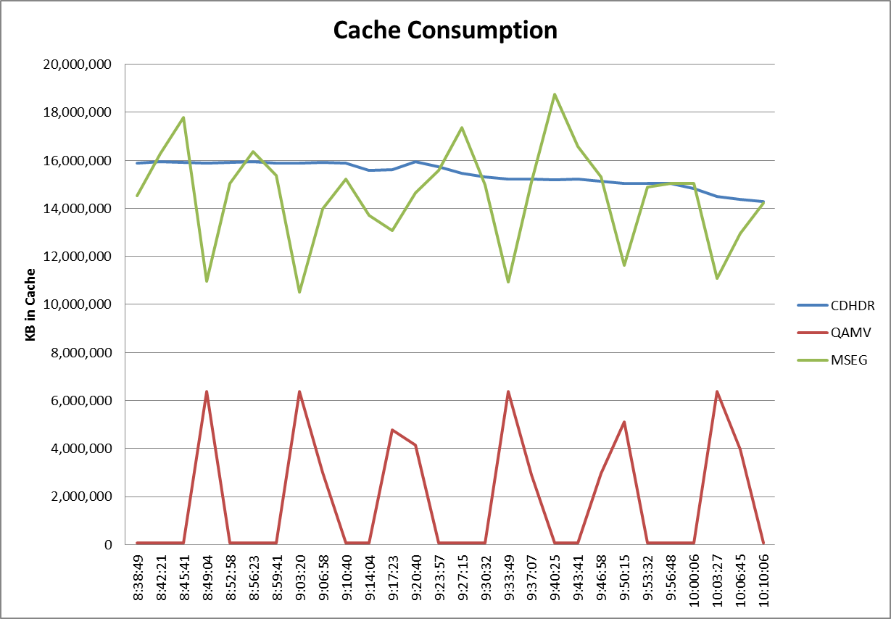
SSD Buffer Extension: Reduce/Eliminate cache flush
A common DBMS problem
Competing user queries
High cache volatility due to large volumes of data being re-read repeatedly
Slow performance as re-reading the same data requires physical reads from slow SAN disks
10’s of ms
SSD Buffer extension
PCIe SSD can be large enough to cache almost entire SAP database
Cache replace
Cache replace
Cache replace
Cache replace
Cache replace
Cache replace
Cache flush
Cache flush
Cache flush
Cache flush
Cache flush

Slide 88
SSD Buffer Extension
Enter PCIe SSD as memory extension
PCIe SSD’s are cheap – e.g. ~$10K per TB
Capacities in ~1TB → 6+ TB
PCIe SSD speeds approaching main memory
<100μsec reads, 10-20μsec writes
ASE 16 sp02 to leverage SSD as memory extension
In normal MRU→LRU buffer management, older data simply migrates seamlessly to SSD
Essentially allows commodity HW to have multi-TB caches at very low TCO
Only limited by ASE’s memory address space of <4TB
Benefits
Reduces IO bottleneck on HBA and SAN disks
Tempdb can be built on PCI SSD
Reduces re-scanning via physical reads from SAN
Doesn’t violate corporate policies/standards of SAN storage for business data
Cache is volatile
Tempdb is rebuilt on reboot, so no permanent data retention either

Slide 89
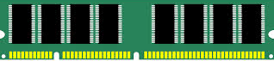

Competitive “Simple” SSD Cache Extension
Extends buffer pools
Conceptually MRU-LRU extended to SSD
Uses hash table to track contents
When full, oldest page is evicted
Associated with the cache (e.g. named cache)
MS SQL 2014
Configured at server level
Only clean pages in SSD cache extension
All writes still to HDD
So, if you want fast writes – you still need to store the data on SSD’s
Limited to ratio of main memory size
32x maximum; 4-8x optimal; 16x suggested
Key benefit: read performance on warm data

Slide 90


ASE 16sp02 “Smart” SSD Buffer Extension
All writes will go first to SSD
ASE internal system daemon will later copy dirty pages from SSD to HDD
Bulk writes (such as bcp) can bypass SSD
Avoids filling SSD with write-once/read rarely data
SSD Cache is associated with DB
Can hold log, table and index pages no matter which cache they are bound to
Adaptive quotas used when SSD is 90%+ full
Single Access Cache Chain/Multi-Access Cache Chain
All pages start in SACC
If read once, attached to SACC
If accessed twice, re-linked to MACC
If LRU reached and page is pushed from cache
SACC – page is removed → reread from HDD if needed
MACC – page is destaged to SSD → reread from SSD
SACC
MACC

Slide 91
Database MemScale Future (est sp03 1H2016)
What does in-memory mean?
For most vendors, it is simply running completely in cache – same LIO efforts, etc. – but some tweaking to minimize overhead
Essentially, we did this with ASE 15.5 with IMDB
ASE 16 In-Memory Row Store (aka Data Row Cache)
Focus is XOLTP – not analytics
In-memory DBMS for analytics….a common use case for DB2 Blue, Oracle Exalytics/In-Memory, etc.
Data values will be stored independently for memory optimized access – e.g. no more parsing of the row ala standard LIO to retrieve values
MVCC will be used for DRC only to eliminate as much concurrency contention as possible
DRC will be persisted (unlike IMDB) and have a redo log separate from transaction log
A good use case is stock trading (market trade/pricing/tick feeds)
Extremely volatile data
Don’t want to have to replay the entire day just to recover to point in time after crash (like with IMDB)

Slide 92
Typical On-Disk Row Access via B-Tree
We traverse the index B-tree to leaf
Leaf node contains page # + rid
Rid essentially is the row number on the page
We fetch the page and look at row offset table on the page
Do a bufsearch() in cache to find (add) page
Row offset table is the byte offset within the page that the row begins
Rows are not necessarily in row offset order
May start that way, but after updates that cause row shrinkage/expansion, etc. the rows might be scattered around on the page
We jump to that byte and read the row
To find a column, we may have to use the variable length column offset table
Net result is multiple indirection/byte count parsing to read column values from a row of data
Data modifications have high overhead
Minimally rewriting the rest of the data row
Often requires rewriting the page
Has impact on currency as we temporary block other readers/writers (using MASS bit)
Page Header
Row 0
(row 0)
Row 1
Row 1
Row 2
(row 2)
Row 3
(row 3)
Cache
hash table
bufsearch()
Data Row Format
Row #
Status Bits
#var len col
Fixed Length Cols
Length var cols
Variable Length Cols
Variable col offset table
Row header
(2 bytes each)
2 bytes
One entry per var length col
(2 bytes each)
“Disk Optimized Storage”

Slide 93
In-Memory Row Store (A Typical Implementation)
Row consists of in-memory optimized storage (an example)
Row header includes versioning info
Each column “cell” is either
a column value (for numerics) (wordsize values)
a pointer to character data allocation
Includes binary()/varbinary(n)
Data Modifications are extremely fast
Make a copy (version of the row)
Modify the desired values
New version linked into cache hash table by using CPU lockless API’s
On-Commit Persistence
When user commits, new versions are written to delta log (typically on SSD)
Cache
hash table
Row #
Version
Status Bits
Col 1
Col 2
Col 3
Col 4
Col 5
Col 6
Row #
Version
Status Bits
456
1.234
0x001
0x002
0x003
0x004
John
Doe
123 Main Street
Sometown USA

Slide 94



ASE DRC/MVCC Architecture – planned for sp03 (1H2016)
SQL Queries & DML on Hot Data
In-Memory Row Store
Data Row Cache (DRC)
Latch-free B-tree indexes
MVCC
Persistent store
Uncompress w/ row optimized access
Design Considerations
Backward compatibility
Tight integration with existing data / tables / architecture
Granularity of caching – Initially per-table, eventually per-partition DRC. Tailored for ILM
Application Changes – Target is to keep them minimal, simple, to none
Memory Requirements – On-demand. Sub-set of table / partitioned can be cached
Dynamic – Target is to allow caching to be dynamically enabled / disabled
Encryption, HA, Replication – Goal is to fully support other features in ecosystem
Monitoring, Advisory, Wizards – Intelligent tooling & monitoring provided to optimally size memory storage for current work loads
MVCC
Data Row Caching
Dump/Load DB
Dump/Load Tran
Backup
Replication
Pack
Heat
Commit time Persistence
Delta log
Normal page-based buffer cache
Compressed or uncompressed
MRU→LRU (strict) or relaxed
On-Disk Row Store Log (ODRS)
Paged I/O
Txn Log

Slide 95
ASE XOLTP vs. MS SQL
XOLTP Feature | ASE 16 sp02, sp03 | MS SQL 2014/2016
Compiled queries | Fully prepared stmts Stmt Cache Queries in Stored Procs | Stored procedures only
Compile query support | Any table/view/proc | Only in-memory tables, limited support of proc language
In-Memory Row Store | Tiered from any table | In-memory tables only
Replication of In-Memory Row Store | Supported | Not supported nor Always-On
Indexing on In-Memory Row Store | Latch-free B-tree on any table | Primarily hash with modified bw-tree
Index & cache locking optimizations | Any table any relaxed cache | In-memory tables only (MVCC)
Concurrency on In-Memory Row Store | MVCC | MVCC
Application Compatibility (e.g. SAP) | Full backward compatibility | App rewrite needed
SSD Buffer Cache Extension | Read/Write w/ MACC | Clean pages only

Slide 96
Workload Analyzer
Capture Replay

Slide 97
ASE Workload Analyzer
New Feature of ASE 16 sp02 (~Q3 2015)
Goals
Analyze workload distribution based on app server, application, login
Allow rapid identification of performance problems
Allow problem mitigation strategies to be tested with real world workloads
Test configuration changes/new feature adoption
Reduce risks/efforts in upgrades & migrations
Implementation
Based on Capture/Replay
ASE Engines perform capture natively
Allows future integration/correlation with MDA data for more accurate impact assessments
Captured workload initially in industry standard PCAP (Protocol Capture) format files
Workload capture loaded into a repository for analysis
All controlled via a simple GUI interface in ASE Cockpit

Slide 98



Workload Analyzer Architecture Overview
Dev/Test
(replay)
ASE Cockpit (Dev/Test)
(capture)
(replay workload)
Workload Analysis Repository
(raw data & analysis)
Production
(capture)
(raw data)
(analysis)
DBA Workstation w/ Cockpit GUI in browser
ASE Cockpit (production)
PCAP files

Slide 99










Digging A Bit Deeper - Capture
ASE Cockpit
ProductionASE
Cockpit Core
Monitor
Administration
Collection
Alert
Replay Engine
Kernel
Network Thread
Receive/ Send
Coordinator
Client Threads
Monitor
Workload Capture and Analyzer
Read TDS
4
3
5
Rapidlog
2
TDS Parser
Analyzer
Presenter
1
Write PCAP File
Repository

Slide 100


Digging A Bit Deeper - Replay
ASE Cockpit
Dev/Test ASE
Cockpit Core
Monitor
Administration
Collection
Alert
6
Replay Engine
Kernel
Network Thread
Receive/ Send
Coordinator
Client Threads
Monitor
Workload Capture and Analyzer
Read TDS
Rapidlog
TDS Parser
Analyzer
Presenter
7
Write PCAP File
Repository

Slide 101
Workload Analyzer KPIs – May 26, 2015
KPI | Measurement | Goal | Current | Note
Performance impact on ASE during capture | as percentage of performance degradation | < 5% | < 5% | Measured with TPCC. Testing with Business Suite in progress
Number of concurrent active connections that can be captured in ASE | as number of concurrent connections | 2000 | 2000
Length of time required to load captured workload into the repository | as length of time require to load requests from workload files | 15 minutes per 2 Mil requests | 10 minutes per 2 Mil requests | Tested with TPC-C Improvements are ongoing
Response time in Cockpit UI | as time required to display a list screen for one connection | < 5 seconds | < 5 seconds | Measured in analysis dashboard drilldown screens
Maximum number of concurrent connections during replay | as number of concurrent, active connections | 2000 | 2000
Rate of replay | as number of requests per second | 500 | 5000 | Measured using TPC-C On 32 core Linux machine 256 GB memory

Slide 102
Phased Delivery
Phase I Workload Analyzer
Capture workload
Analyze workload
Phase III*
Automation
Replay from multiple hosts
Compare captured workloads
Graphical user interface
Automate replay test system setup
Phase II*
Performance Analysis
• Usability improvements
• Performance improvements
• Integration with historical
monitoring data
• Advisors (index, partition, etc)
* May occur over multiple releases
Replay workload
* Features in future releases subject to change

Slide 103
Summary
Roadmap

Slide 104
SAP ASE Roadmap – Customer Accessible via SMP Product road map overview – key themes and capabilities
Extreme transaction processing
Linear scalability up on 80 cores
Partition level locking
Dynamic Thread Assignment
Storage/operational simplicity
Index and Data Compression
Analytics Query performance
Security
Full Database Encryption
Residual data removal
TCO enhancements
SCC - Compression advisor utility
SCC - Database backup scheduling
HANA integration
Data interchange/access between ASE/HANA
ASE CE
Performance enhancements for 15.7 SP130 Cluster Edition
Extreme transaction processing
Compiled queries – machine code
Flash integration – buffer extension
Transactional memory
Storage & operational simplicity
Workload capture & replay
Heat map for data tiering
ASE Cockpit support for workload analysis and data tiering
Cloud support
Support major cloud providers
HANA integration
ASE report acceleration with no code changes
Integration with HANA ecosystem and tooling
HA/DR architecture
HADR support for custom applications
ASE CE – ASE 16 support, metro cluster,
optimizations
Security
Granular auditing
Business Suite
Integrated “zero data loss” HA/DR via
synch replication
Support for full database encryption
Extreme transaction processing
Dynamic in-memory row store w/ MVCC
Flash integration - optimizations & integration with heat map
Storage/operational simplicity (TCO)
Workload capture/replay (historical repository integration)
Granular heat map technology
Information Lifecycle Management
Parallel utilities; hot patch update
Online cache shrinking
ASE Cockpit enhancements
Cloud support
Support flexible security models
Cloud backup
HANA integration
Analytics development in HANA, on ASE data
Flexible deployment on ASE or HANA
Unification of administration, management,.
HA/DR
Flexible deployments for HADR – sync rep
ASE CE–Business Suite support, single binary
Security
Data masking for sensitive data
Audit repository
(ASE 16, ASE CE 15.7 SP130)
* Available for Business Suite Customers only
This is the current state of planning and may be changed by SAP at any time.

Slide 105

Questions???
Clarifications…
Discussion…
Follow-up…

Slide 106
Thank you
For more information on SAP ASE 16 visit: fm.sap.com/ase16

